Slide 1
Statically Equivalent Systems
Dr. Jacob Moore
Associate Professor of Engineering
Penn State Mont Alto

Slide 2
Statically Equivalent Systems
Two sets of forces are considered statically equivalent if they cause either the same linear and angular accelerations, or if they would cause the same set of reaction forces and moments when applied to a body.
In this way the two sets of forces are considered interchangeable for statics or dynamics problems.
In engineering analysis, we will often use statically equivalent systems to replace a complex set of forces with a much simpler, single force or a force and moment to make later analysis easier.

Slide 3
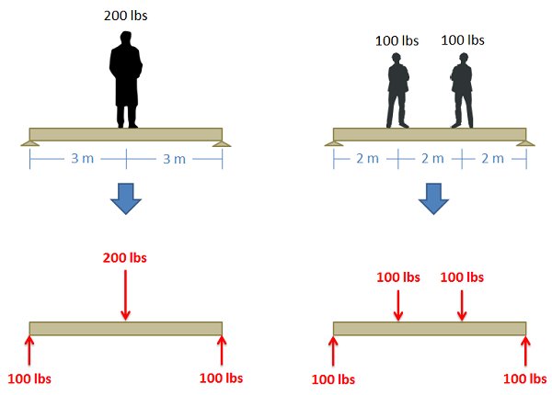
Statically Equivalent Systems

Slide 4
Determining if Sets of Forces Are Statically Equivalent
To determine if two sets of forces are statically equivalent, we have several options
We could determine the accelerations caused by each set of forces and compare them.
We could determine the reaction forces caused by each set of forces and compare them.
We could add all the force vectors in each case and compare and determine the net moment about the same point in each case and compare.

Slide 5
Thanks for Watching
See other engineering mechanics videos and access the full tool at…

Slide 6
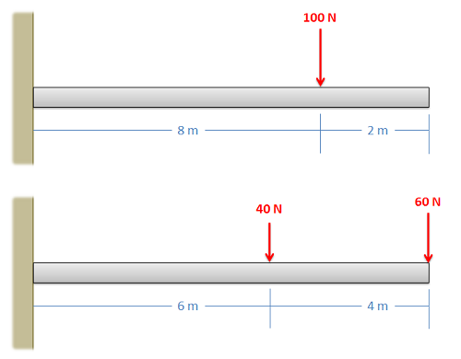
Statically Equivalent Systems Worked Example
Determine if the two sets of forces are statically equivalent.

Slide 7
Statically Equivalent Systems Worked Example
Determine if the two sets of forces are statically equivalent.
60 lbs
6 ft
4 ft
80 lbs
20 lbs
2 ft
4 ft
6 ft

Slide 8

Statically Equivalent Systems Worked Example
Two alternate sets of forces are shown on a car. Determine if the two sets of forces are statically equivalent.
5 ft
4 ft
5 ft
4 ft
G
80 lbs
G
2.5 ft
2.5 ft
30 lbs
50 lbs
1400 lbs
1400 lbs
600 lbs
600 lbs
800 lbs
800 lbs

Slide 9
Statically Equivalent Systems Worked Example
A valve handle as shown below is subjected to two sets of forces and moments. Determine if the two sets of forces and moments are statically equivalent
80 N
50 N
80 N
30 N
70 cm
30 Nm
16 Nm
70 cm
80 N
80 N
60 N

